Slide 1
IELTS WRITING 1

Slide 2

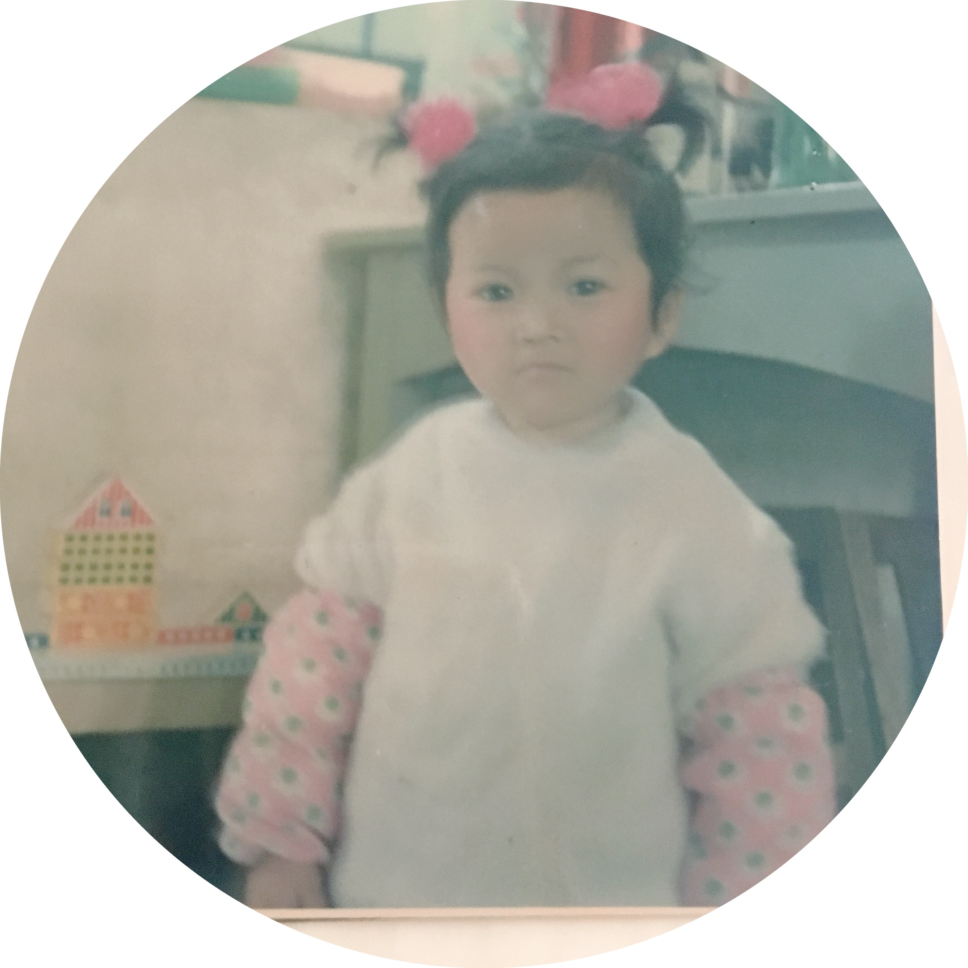



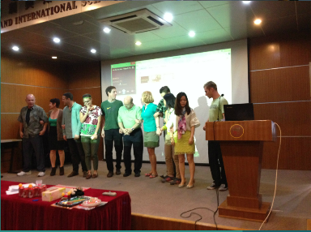
自我简介
About me…
2016.9-Now
Teacher-
IELTS Writing
(New Channel, Wuhan)
2011.9-2013.06
Master’s Degree-
International Business Negotiation
(ESC Rennes)
2013.9-2015.06
English Teacher-
(Oxstand International School,
Shenzhen)
2008.9-2012.06
Bachelor’s Degree-
English Translation
(ZUEL)

Slide 3
雅思写作-小作文简介
小作文动静态区分
小作文首段写作
动态图词汇/句型/衔接积累
单线描写练习

Slide 4
PART1
雅思写作
Task1小作文简介

Slide 5
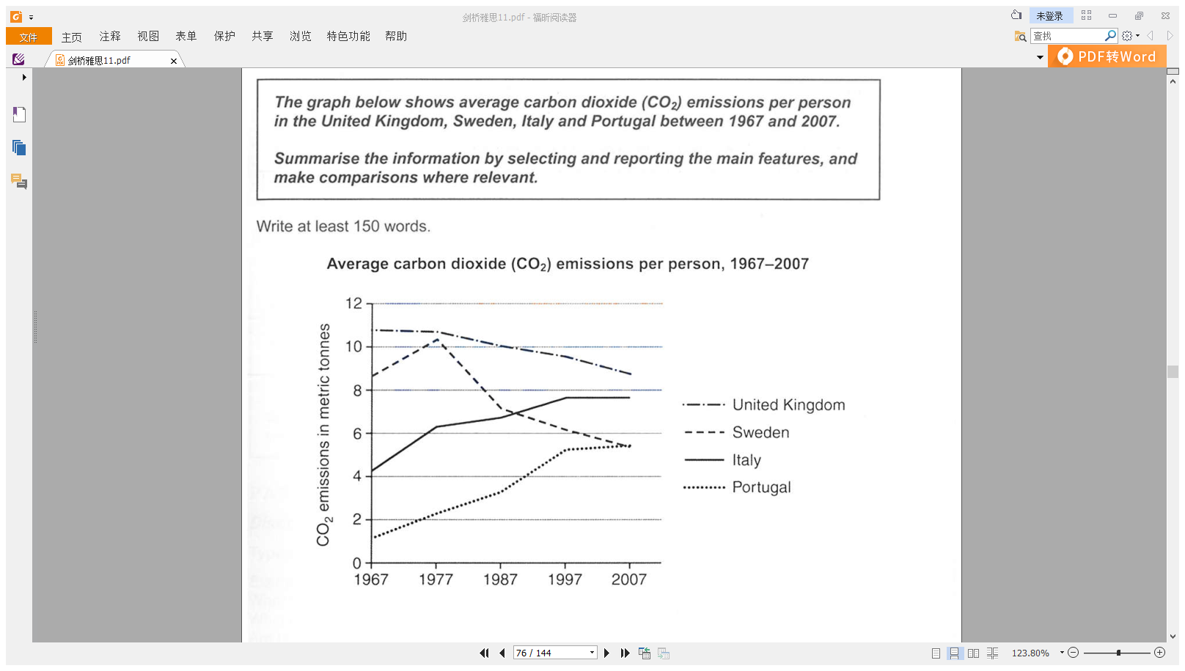
Task1小作文简介
题干构成
文字描述
答题要求
图表

Slide 6
Task1小作文简介
题干构成
文字描述
答题要求
图表

Slide 7
Task1小作文简介
题干构成
文字描述
答题要求
图表

Slide 8
Task1小作文简介
任务内容: 用客观的语言来清晰准确地描述图表、图像。
篇幅要求: 150词以上。
写作时长：约20分钟。
算分方式：约占写作总分1/3。

Slide 9
Task1小作文简介
题干构成
文字描述
答题要求
图表

Slide 10
Task1小作文简介
图表类型
Line graph 线图
(C11T2W1)

Slide 11
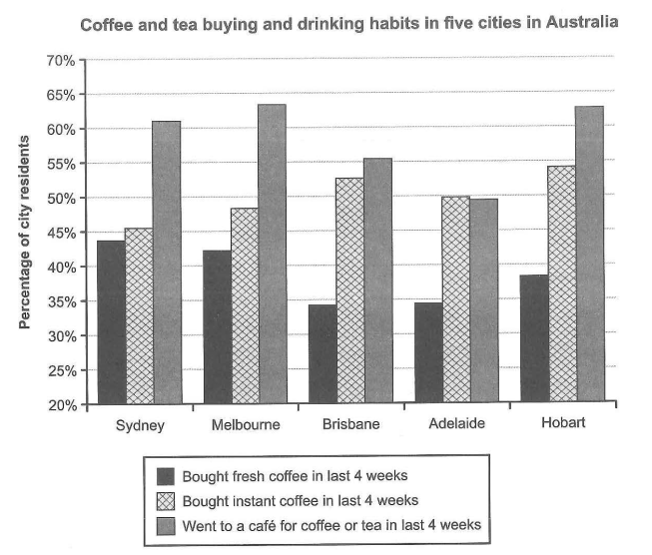
Task1小作文简介
图表类型
Line graph 线图
Bar chart 柱状图
(C15T1W1)

Slide 12
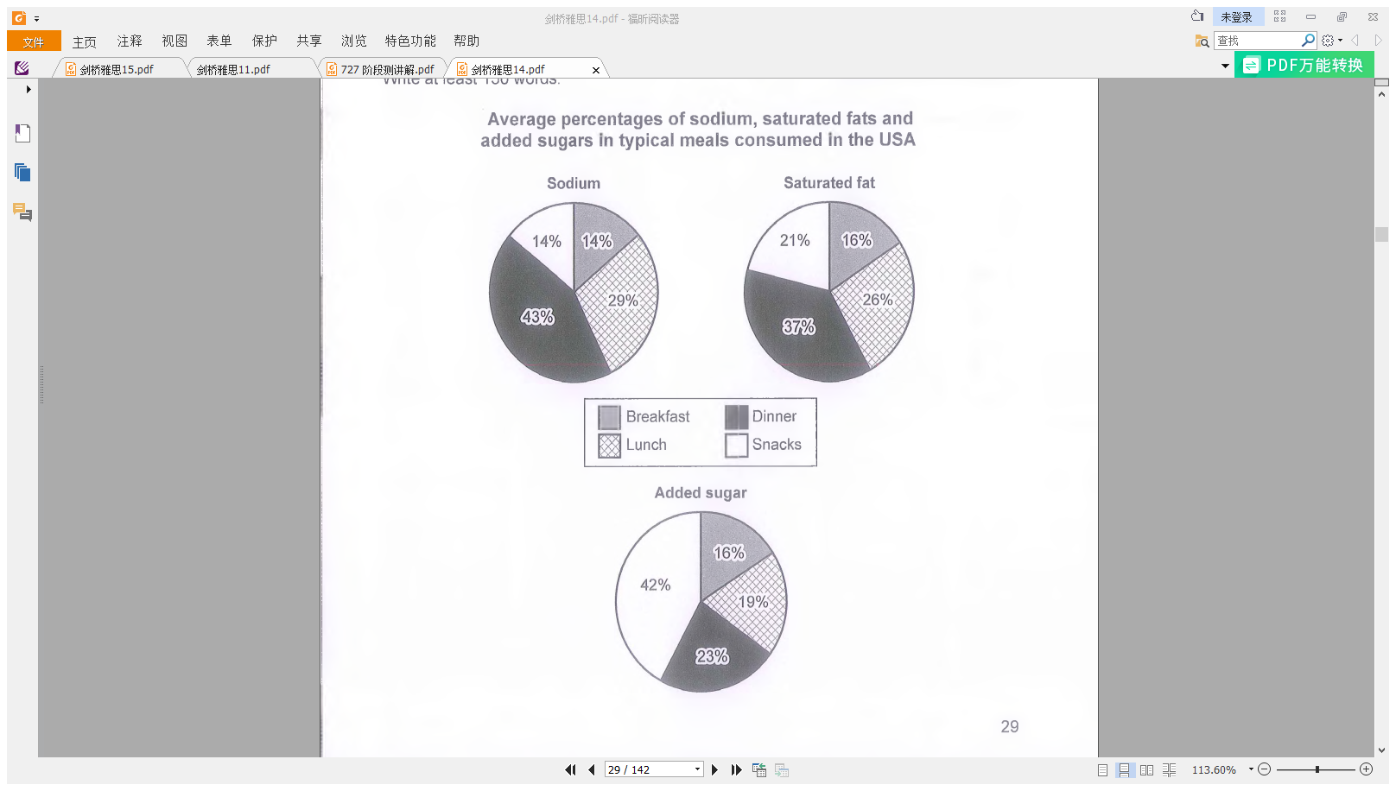
Task1小作文简介
图表类型
Line graph 线图
Bar chart 柱状图
Pie chart 饼图
(C14T1W1)

Slide 13
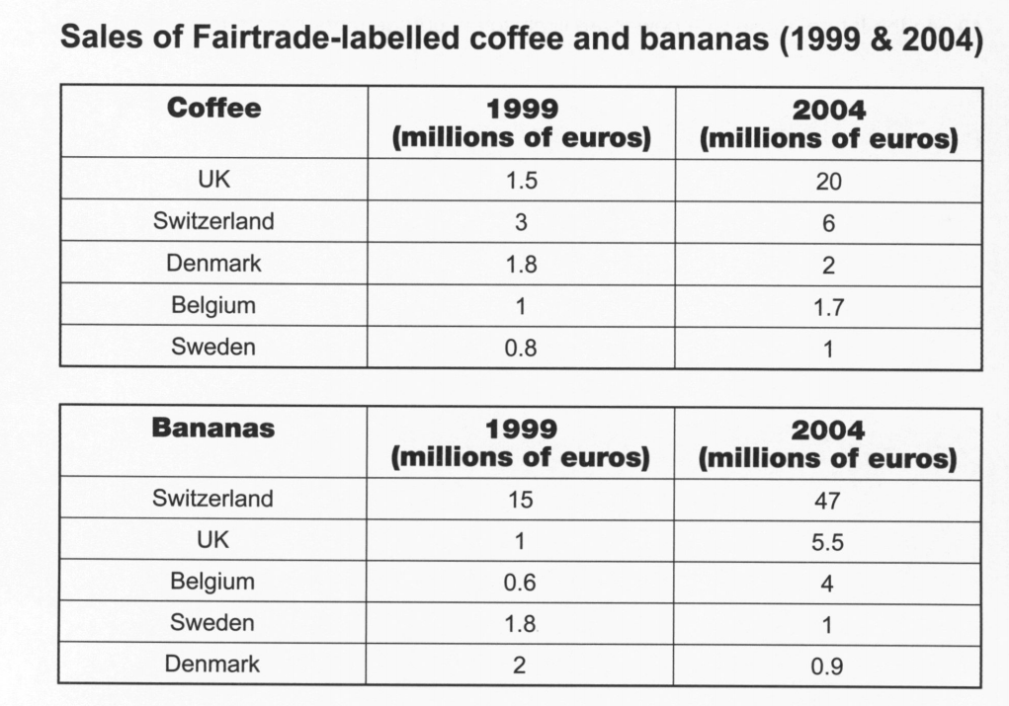
Task1小作文简介
图表类型
Line graph 线图
Bar chart 柱状图
Pie chart 饼图
Table 表格
(C10T2W1)

Slide 14
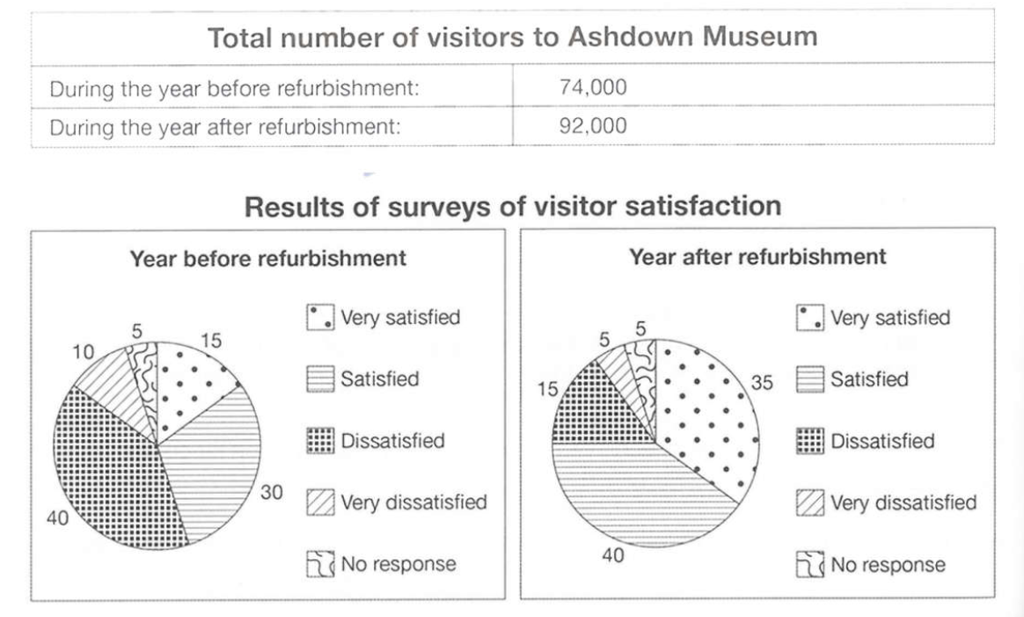
Task1小作文简介
图表类型
Line graph 线图
Bar chart 柱状图
Pie chart 饼图
Table 表格
混合数据图
(C11T4W1)

Slide 15
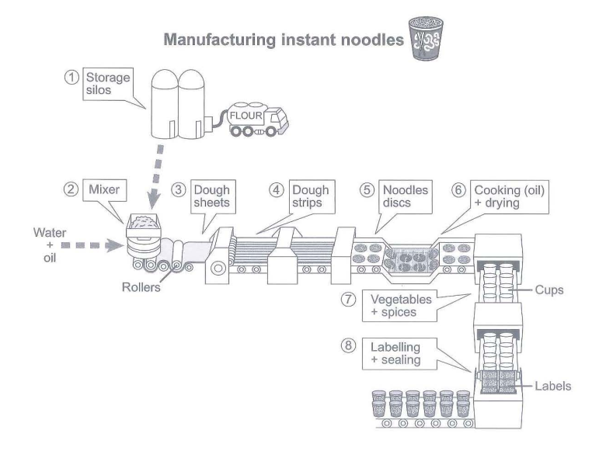
Task1小作文简介
图表类型
Line graph 线图
Bar chart 柱状图
Pie chart 饼图
Table 表格
混合数据图
Flow chart 流程图
(C15T3W1)

Slide 16
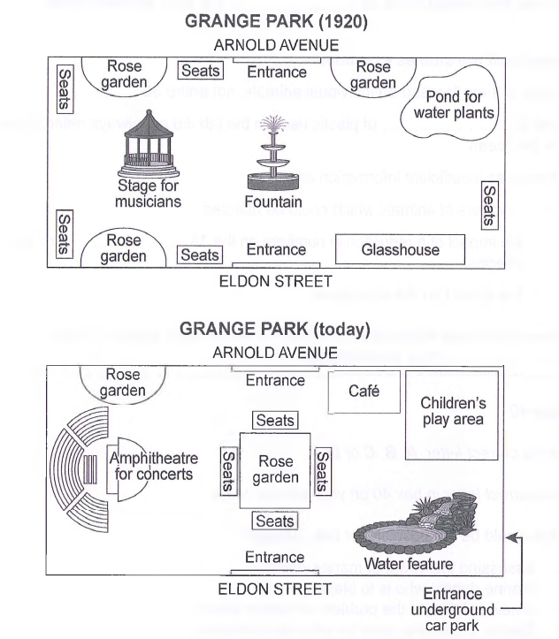
Task1小作文简介
图表类型
Line graph 线图
Bar chart 柱状图
Pie chart 饼图
Table 表格
混合数据图
Flow chart 流程图
Map 地图
(C14T4W1)

Slide 17
Task1小作文简介
图表类型总结
Line graph 线图
Bar chart 柱状图
Pie chart 饼图
Table 表格
混合数据图
Flow chart 流程图
Map 地图
数据类图表
（考察频率更高）
非数据类图表
（考察频率更低）

Slide 18
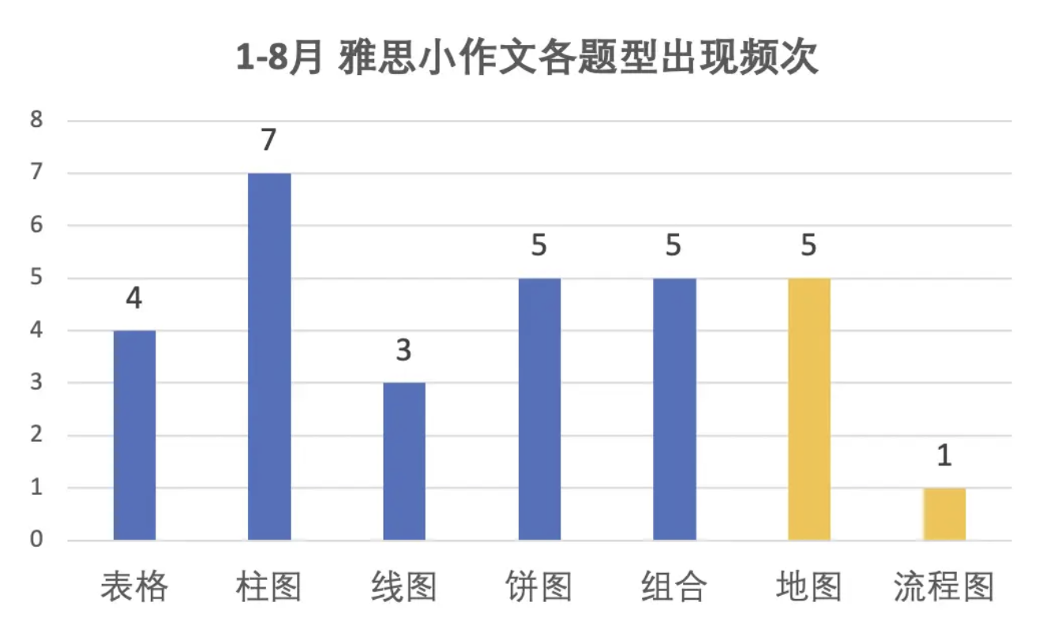
Task1小作文简介
图表类型总结

Slide 19
PART2
小作文动静态区分

Slide 20
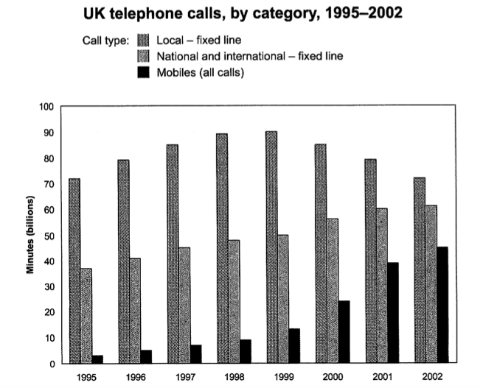
小作文动静态区分（数据图）
有时间变化：有趋势 => 动态图
线图、柱图
(C11T2W1)
(C9T2W1)

Slide 21
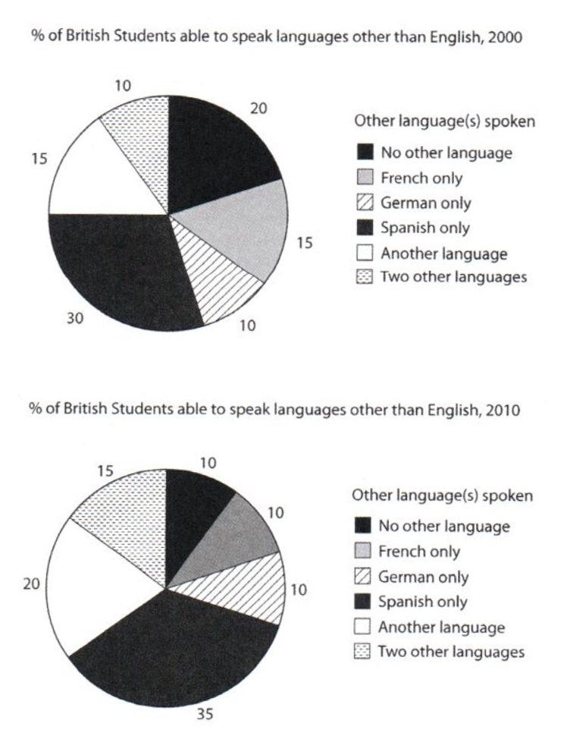
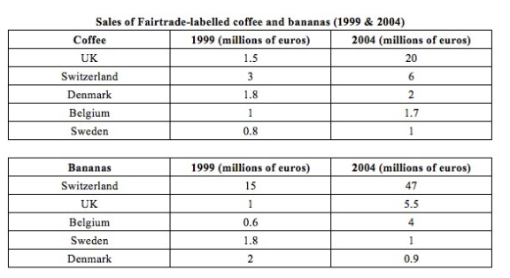
小作文动静态区分（数据图）
有时间变化：有趋势 => 动态图
线图、柱图、饼图、表格
(C10T2W1)
(C11T2W1)

Slide 22
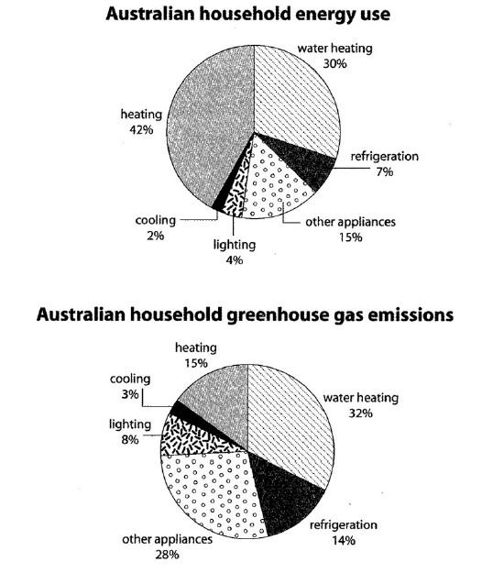
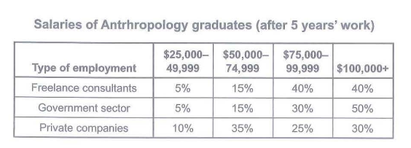
小作文动静态区分（数据图）
无时间变化：无趋势 => 静态图
(C15T1W1)
(C10T1W1)
(C15T4W1 fig.1)

Slide 23
PART3
小作文首段写作
小作文首段同义替换总结

Slide 24
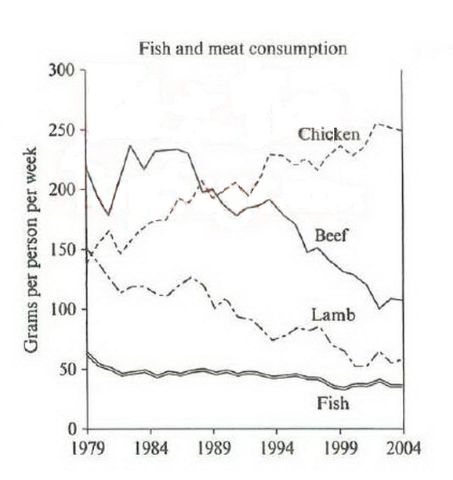
小作文首段写作范例
The graph below shows the consumption of fish and some different kinds of meat in a European country between 1979 and 2004.
Sample:
The graph illustrates changes in the amounts of beef, lamb, chicken and fish consumed in a particular European country between 1979 and 2004.
(C7T2W1)

Slide 25
小作文首段写作范例
The graph below shows the consumption of fish and some different kinds of meat in a European country between 1979 and 2004.
The graph illustrates changes in the amounts of beef, lamb, chicken and fish consumed in a particular European country between 1979 and 2004.
同义替换
(C7T2W1)

Slide 26
小作文首段写作范例
The graph below shows the consumption of fish and some different kinds of meat in a European country between 1979 and 2004.
The graph illustrates changes in the amounts of beef, lamb, chicken and fish consumed in a particular European country between 1979 and 2004.
同义替换
(C7T2W1)

Slide 27
小作文首段同义替换总结
chart=graph= diagram
A chart is a diagram, picture, or graph which is intended to make information easier to understand. 图表 (注意: table 和 map 不与以上替换; flow chart = process diagram)
show = present = indicate = illustrate = give information about
(当图表中只有两个分析对象时，可替换成compare)
percentage = proportion
number/amount = quantity
kind = type = sort ≈ category ≈ group
If you talk about a particular kind of thing, you are talking about one of the types or sorts of that thing. 种类
If people or things are divided into categories, they are divided into groups in such a way that the members of each group are similar to each other in some way. 种类; 范畴
=> the percentage/number of = the figure for

Slide 28
小作文首段同义替换总结
时间段 e.g. 1998-2018
from 1998 to 2018
between 1998 and 2018
over the period between 1998 and 2018
over the 1998-2018 period
over the 20-year period
over the two decades
(over= during 在...期间)

Slide 29
小作文首段写作范例
The graph below shows the consumption of fish and some different kinds of meat in a European country between 1979 and 2004.
The graph illustrates changes in the amounts of beef, lamb, chicken and fish consumed in a particular European country between 1979 and 2004.
同义替换
概括/具体
(C7T2W1)

Slide 30
小作文首段写作
概括/具体
The graph below shows the consumption of fish and some different kinds of meat in a European country between 1979 and 2004.
The graph illustrates changes in the amounts of beef, lamb, chicken and fish consumed in a particular European country between 1979 and 2004.
项目数≤3时, 可照搬所有项目名称
项目数>3时, 可用 …(同替), such as / including … 列举部分项目名称
(e.g. seven different sorts of meat, including beef, lamb and so on, …)

Slide 31
小作文首段写作范例
The graph below shows the consumption of fish and some different kinds of meat in a European country between 1979 and 2004.
The graph illustrates changes in the amounts of beef, lamb, chicken and fish consumed in a particular European country between 1979 and 2004.
同义替换
概括/具体
句式变换
(C7T2W1)

Slide 32
小作文首段写作
句式变换 (名词 <=> 从句)
The graph below shows the consumption of fish and some different kinds of meat... （原题）
=> The graph illustrates changes in the consumption of...(范文)
=> The graph shows how the consumption of beef, lamb, chicken and fish changed...
change (n.) /trend (n.) 注意单复数 <=> how … change (v.)/alter (v.) 注意时态
The graph below shows the differences in exports of two countries in 2000.
=> The graph shows how exports between China and America differed from each other in 2000.
difference (n.) 注意单复数 <=> how … differ (v.) /vary (v.) 注意时态

Slide 33
小作文首段写作
句式变换 (分词做定语 <=> 定语从句)
The table below shows the percentage of journeys made by different forms of transport in four countries. (原题)
=> The table presents the proportion of journeys which were made by different forms of transport in four countries. (改写)
n. done <=> n. which be done (过去分词 <=> 被动语态)
n. doing <=> n. which/who do (现在分词 <=> 主动语态)

Slide 34
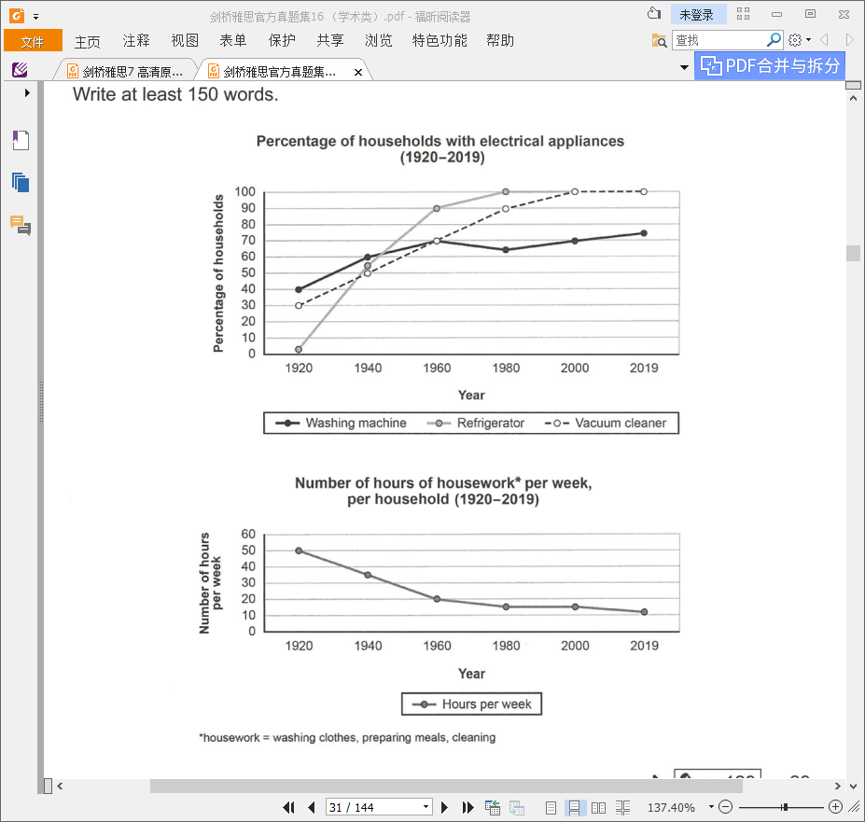
小作文首段写作练习
Practice (C16T1W1)
The charts below show the changes in ownership of electrical appliances and amount of time spent doing housework in households in one country between 1920 and 2019.
图A shows …, and / while图B describes….
(图A和图B为同一类型图表时，则The charts/graphs indicate...and...)

Slide 35
小作文首段写作练习
Practice (C16T1W1)
The charts below show the changes in ownership of electrical appliances and amount of time spent doing housework in households in one country between 1920 and 2019.
同义替换
sample answer
The line graphs give information about how the percentage of households with washing machine, refrigerator and vacuum cleaner and the time which were spent on housework per week changed in a particular country over the 1920-2019 period.
概括/具体
句式变换

Slide 36
PART4
动态图写作基础词汇
动态图写作基础句型
动态图写作衔接手段

Slide 37
动态图写作基础词汇
变化趋势
变化幅度
极值
交点
引出数据的介词

Slide 38
动态图写作基础词汇
变化趋势
变化幅度
极值
交点
引出数据的介词

Slide 39
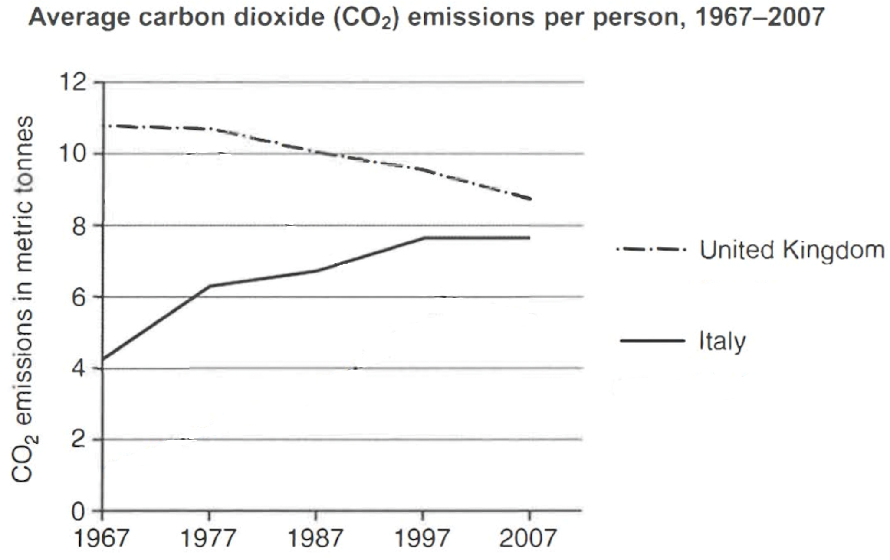
动态图写作基础词汇
变化趋势
增加/上升
动词 | （冠词+）名词
increase | an increase
rise | a rise
climb | a climb
grow | a growth
improve | an improvement
go up | an upward trend
creep up=gradually rise | /
surge=suddenly rise | a surge
C11T3

Slide 40
动态图写作基础词汇
变化趋势
减少/下降
动词 | （冠词+）名词
decrease | a decrease
fall | a fall
decline | a decline
drop | a drop
go down | a downward trend
slide =gradually decrease | /
plunge/plummet =suddenly decrease | a plunge
C11T3

Slide 41
动态图写作基础词汇
变化趋势
保持不变
动词词组
remain/keep/saty the same
remain static/steady/unchanged
show a stability
level off/out （ If a changing number or amount levels off or levels out, it stops increasing or decreasing at such a fast speed. 趋向稳定）
C11T3

Slide 42
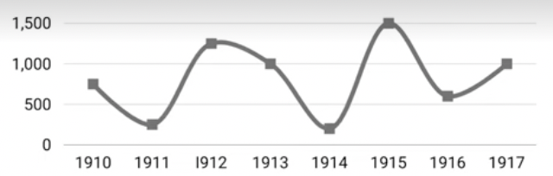
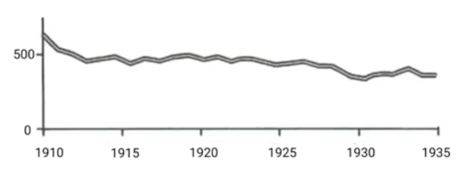
动态图写作基础词汇
变化趋势
波动（不规则变化）
动词 | 名词
fluctuate | fluctuation(s)

Slide 43
动态图写作基础词汇
变化趋势
变化幅度
极值
交点
引出数据的介词

Slide 44
动态图写作基础词汇
变化幅度
显著的/地
显著的/地
形容词 | 副词
significant | significantly
great | greatly
noticeable | noticeably
marked | markedly
dramatic | dramatically
substantial | substantially
considerate | considerately

Slide 45
动态图写作基础词汇
变化幅度
显著的/地
适中的/地
适中的/地
形容词 | 副词
moderate | moderately
steady | steadily

Slide 46
动态图写作基础词汇
变化幅度
显著的/地
适中的/地
轻微的/地
微小的/地
形容词 | 副词
slight | slightly
marginal | marginally
gradual | gradually
modest | modestly

Slide 47
动态图写作基础词汇
变化趋势
变化幅度
极值
交点
引出数据的介词

Slide 48
动态图写作基础词汇
最高点 n.
the peak = the top = the highest point
到达/升至(值为…的)最高点 v.
reach the peak (n.) at …
increase to the peak (n.) at …
peak (v.) at …
最低点 n.
the bottom = the lowest point
到达/降至(值为…的)最低点 v.
reach the bottom (n.) at …
decrease to the bottom (n.) at …
bottom (v.) out at …

Slide 49
动态图写作基础词汇
变化趋势
变化幅度
极值
交点(不是描述静态的相交于，而是描述动态的超过/被超过)
引出数据的介词

Slide 50
动态图写作基础词汇
超过 v.
outnumber (在数量上)超过
exceed (在数量上)超过
outstrip (在数量/重要性上)超过
overtake (在数量/重要性上)超过
The consumption of chicken overtook that of lamb in 1980.
鸡肉消耗量在1980年追上了羊肉消耗量。

Slide 51
动态图写作基础词汇
变化趋势
变化幅度
极值
交点
引出数据的介词

Slide 52
动态图写作基础词汇
from … to … / by … 表升/降幅度
The consumption of chicken increased from 150 grams to 250 grams.
The consumption of chicken increased by 100 (=250-150) grams.
between … and … / in a range of 表波动幅度
The sales of car fluctuated between 2 million and 3.5 million.
The sales of car fluctuated in a range of 1.5 (=3.5-2) million.
at … 描述对象/主语指数值/百分比
The percentage(主语) peaked at 85% before a continuous drop.
with … 描述对象/主语不指数值/百分比
In 1979 beef(主语) was the most popular, with about 225 grams.

Slide 53
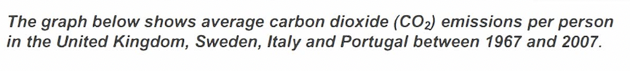
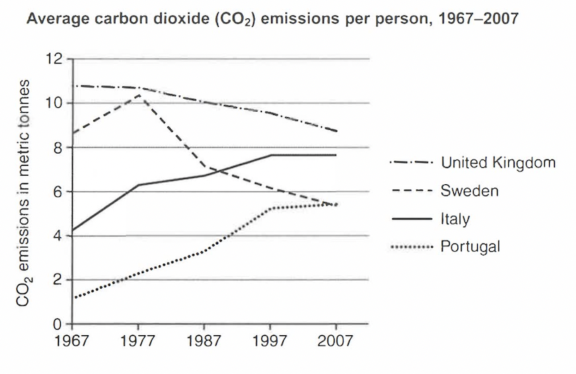
动态图写作基础句型
C11T3
动态图基础句型成分：
描述对象
变化趋势
变化幅度
数值
时间段

Slide 54
动态图写作基础句型
C11T3
句型一：描述对象 + 变化趋势动词 + 变化幅度副词+ 数值+时间段
例句：1967年到2007年，意大利的人均碳排放量从刚刚超过4公吨显著增长到大约8公吨。
e.g. The average CO2 emissions per person in Italy increased significantly from just about 4 metric tonnes to around 8 metric tonnes between 1967 and 2007.

Slide 55
动态图写作基础句型
C11T3
句型二：There be + a/an + 变化幅度形容词 + 变化趋势名词+ 数值 + in 描述对象 + 时间段
e.g. There was a significant increase from just about 4 metric tonnes to around 8 metric tonnes in the average CO2 emissions per person in Italy between 1967 and 2007.

Slide 56
动态图写作基础句型
C11T3
句型三：时间（名词短语） + see/ experience/ witness a/an + 幅度形容词 + 趋势名词 +数值 + in 描述对象
见证：witness = see = experience
e.g. The period between 1967 and 2007 witnessed a significant increase from just about 4 metric tonnes to around 8 metric tonnes in the average CO2 emissions per person in Italy.

Slide 57
动态图写作基础句型
C11T3
句型四：A/An + 幅度形容词 + 变化趋势名词 + take place/ occur + in 描述对象 + 时间段
e.g. A significant increase by around 4 metric tonnes took place/occurred in the average CO2 emissions per person in Italy between 1967 and 2007.

Slide 58
动态图写作基础句型练习：
C11T3
Exercise：
请描写图中UK的人均CO2排放趋势。
————————————————————————————————————————————————————————————————————————————————————————————————————————————————————————————————————————————————

Slide 59
动态图写作衔接手段
C11T3
连接方式一：
现在分词作状语：starting at, beginning from，
（通常可以在描述数据的开头时使用）
e.g.Starting at around 4 metric tonnes, the average CO2 emissions per person in Italy showed an upward trend by about 2 metric tonnes between 1967 to 1977(主句-趋势句1).

Slide 60
动态图写作衔接手段
C11T3
连接方式二：
表示时间的连词：before, after，后面接完整句子或者现在分词(v-ing)
e.g. The average CO2 emissions per person in Sweden increased steadily from 1967 to 1977 before（+完整句子）it dropped dramatically to around 7 metric tonnes in 1987.
e.g. The average CO2 emissions per person in Sweden increased steadily from 1967 to 1977 before（+现在分词）dropping dramatically to around 7 metric tonnes in 1987.

Slide 61
动态图写作衔接手段
C11T3
表连接方式三： 表示并列and then
或转折but的连词
e.g. The period from 1977 to 1987 witnessed a considerable drop in the average CO2 emissions per person in Sweden from just above 10 metric tonnes to around 7 metric tonnes(趋势句3), and then a steady fall took place between 1987 to 2007(趋势句4).

Slide 62
动态图写作衔接手段
C11T3
连接方式四：过去分词作状语：followed by（紧接着…），+ a/an + 幅度形容词+趋势名词
e.g. The period from 1977 to 1987 witnessed a considerable drop in the average CO2 emissions per person in Sweden from just above 10 metric tonnes to around 7 metric tonnes, followed by a steady fall between 1987 to 2007.

Slide 63
动态图写作衔接手段
C11T3
连接方式五：
副词：after this, following this period, thereafter, however
e.g. The average CO2 emissions per person in Sweden increased steadily from 1967 to 1977; after this, it dropped dramatically to around 7 metric tonnes in 1987.（放句中）
e.g. After this, The average CO2 emissions per person in Sweden dropped dramatically to around 7 metric tonnes in 1987.（放开头）

Slide 64
PART5
单线写作练习
课后作业

Slide 65
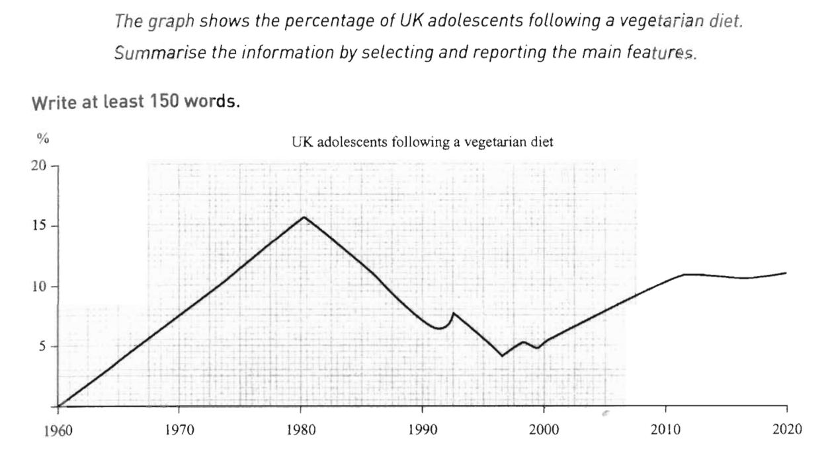
单线写作练习(胡敏雅思7代第23页）

Slide 66
单线写作练习
2
3
4
1

Slide 67
单线写作练习
连接方式一+趋势句型一
Starting at 0%, the percentage of adolescents adopting a vegetarian diet in the UK significantly increased by 15% during the first two decades.
2
3
4
1

Slide 68
单线写作练习
连接方式五+趋势句型三
However, the period from 1980 to 1990 saw a dramatic fall to around 5% in the percentage of adolescents following/ adhering to a vegetarian diet in the UK.
2
3
4
1
Notes:
adhere to: to behave according to a particular law, rule, set of instructions, etc.; to follow a particular set of beliefs or a fixed way of doing sth 坚持，遵守，遵循（法律，规章，指示，信念等）

Slide 69
单线写作练习
连接方式五+趋势句型一
Then, the percentage of adolescents following/ adhering to a vegetarian diet showed fluctuations in a range of around 5% in the UK
2
3
4
1

Slide 70
单线写作练习
连接方式二+趋势句型一
, before it increased steadily to above 10% from 2000 to 2020.
, before increasing steadily to above 10% from 2000 to 2020.
2
3
4
1

Slide 71
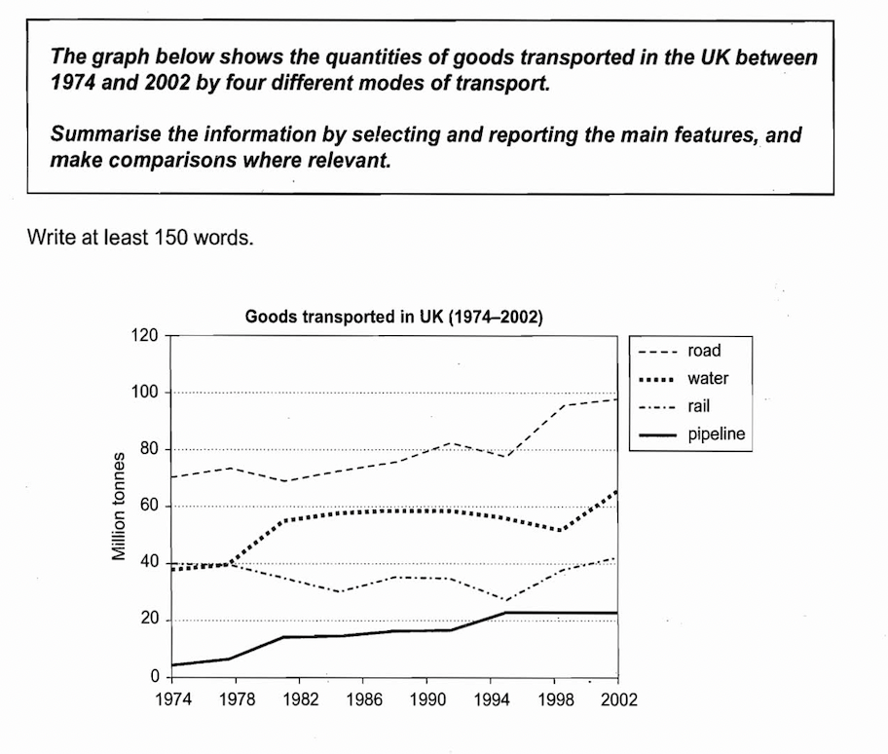
课后作业
首段改写练习：
C8T4W1首段改写
单线图写作练习：
C8T4W1四个单线趋势句
（四句话分别概括这四条线的总趋势，尽量用不同的趋势句型）
C8T4W1

